Slide 1
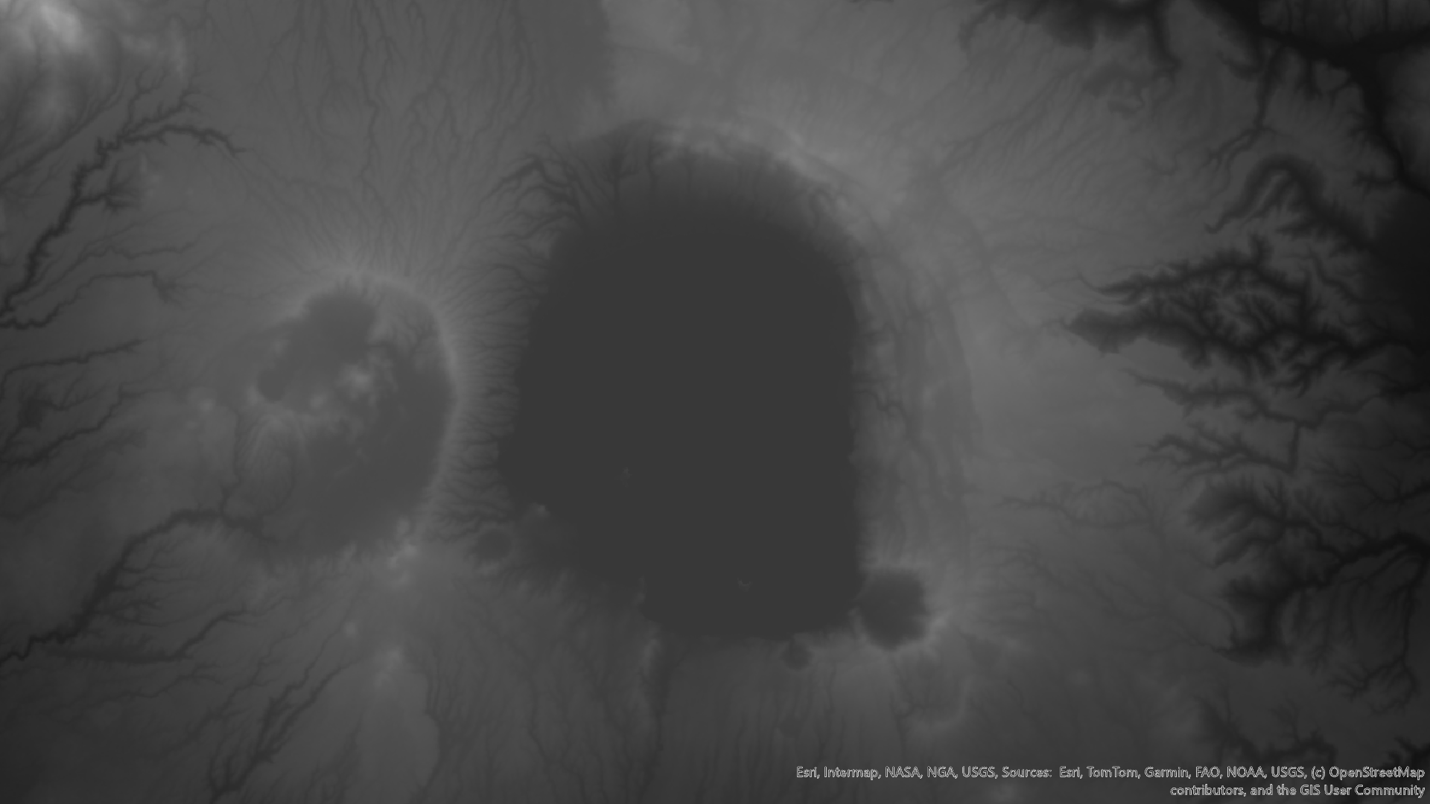
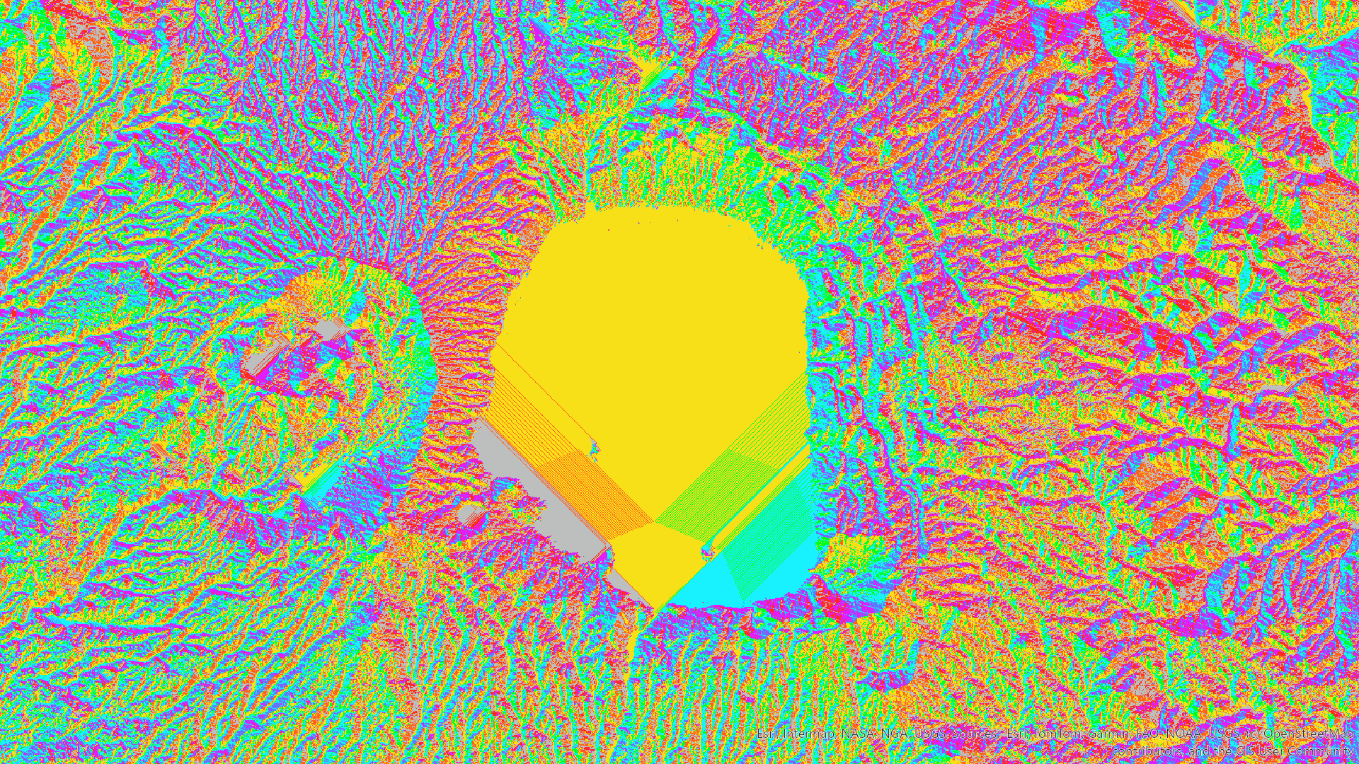
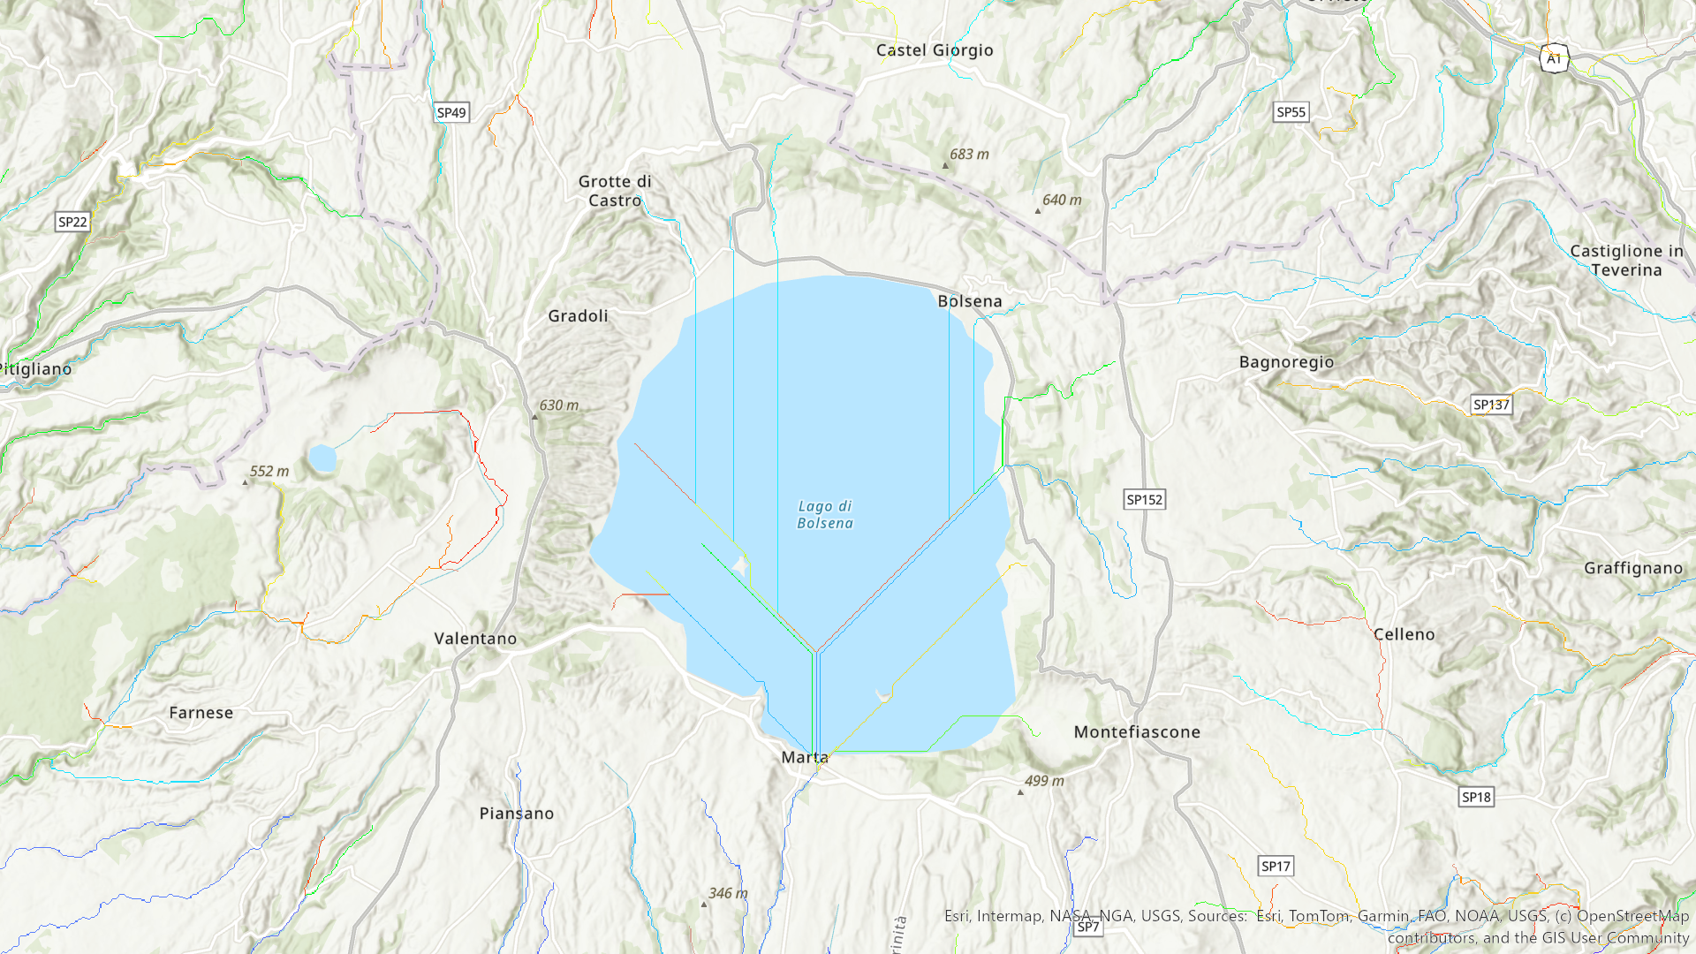
Presenters: Luke Faulker (History Undergraduate) (He/Him)
Trey Parrott (History Undergraduate) (He/Him)
Mentors: Dr. Kathryn Jasper (History Department) (She/Her)
The Romans understood how to transport non-pressurized water through channels and ditches. In the case of pressurized water, the Romans used pipes that were primarily made of ceramic, lead and/or stone. Throughout countryside villas, Elites built water features to show prestige and power. This was common in urban areas as well; however, the key difference is the structural design of these fountains. In urban areas, aqueducts were associated with the prestige of urban life. However, on the rural countryside, there was less of a need (and/or a lack of care) for an aqueduct for its population. It would not have been practical to have one. This points us towards answering why the fountain at Valle Gianni does not have an aqueduct.
The Nymphaeum of Valle Gianni – Location as a Water Feature
Villas and Water Features
This project is based on the archeological site Valle Gianni, located in central Italy near Lake Bolsena. The site has a Roman nymphaeum (fountain) and is theorized to be part of a villa. The location of the nymphaeum is puzzling, primarily because the fountain is far from the nearest aqueduct. The site sits on a natural aquafer, but the lake is primarily fed by watershed from the surrounding hills. The nymphaeum at Valle Gianni is also larger than expected for the location, and there is evidence of a more extensive pipe network. The objective of this research project is to connect the watershed routes around the site to the potential pipe network that fed and drained the fountain and theorize about the location. In the future, the archeologists and historians focused on Valle Gianni may be able to use this project to inform potential population datasets for the Lake.
Introduction and Objectives
Hydrology Images
A visualization of the original DEM (digital elevation model) which is a measurement of terrain height. These scans are done professionally and this DEM specifically contained much of central Italy. This DEM is central for the hydrological analysis of the lake.
For this research project, the primary method for analyzing and creating hydrologic data is ARCGIS PRO, a powerful geographic tool. Using Digital Elevation Models or DEMs, we can create a watershed raster, which allows for further analysis of watershed routes. The spatial analysis of the watershed route is coupled with descriptors of the Roman nymphaeum from Roman authors and Roman historians, which explain how the fountain could have been fed and drained.
Historical, archaeological, and scientific scholarship have been the backbone of understanding the hydrology of Valle Gianni’s nymphaeum. Using primary sources that reveal the Roman understanding of water and how they used it to their benefit has been fundamental to this project. Additionally, the information from the diaries of archaeologists at Lake Bolsena has been important for understanding what has been found and for their understanding of our case study. Using histories of Roman architecture, settlement patterns, and agricultural technologies has provided further insight into the case study.
Methods and Research
This image is a visualization of the water flow. Each color is a cell that has an assigned value which dictates the direction of flow. From this layer, many hydrological process can be analyzed and extrapolated. This visualization has the errors in the original DEM filled in for accuracy.
This image is a visualization of the individual streams extrapolated from the flow direction above. These streams are tagged individually and can be edited by hydrologists to find specific data.

